Slide 1
Development of contactless playback of analog records to digital sound files
IASA Nordic Branch 26th-27th May 2015
National Library of Sweden (KB)
Stig L Molneryd
Notes:
Conference 26th-27th May 2015- IASA Nordic Branch, Copenhagen / Stig L Molneryd VINNOVA project at the National Library of Sweden (KB)
A brief presentation of how the innovation and development projects started at KB. The project is an innovation procurement PCP (Pre Commercial Procurement) intitled "Development of contactless playback of analog records to digital sound files"

Slide 2
In the archive a total number of records at KB
Total amount of about 146 000 Swedish records
80 000 78 rpm
60 000 vinyl records EP, Singel, LP
6 000 lacquer discs
Swedish Radio,(SR) have about 285 000 records
Notes:
We at the National Library of Sweden have today a total amount of about 146 000 Swedish records, of which around 80 000, 78 rpm, 60,000 vinyl records and 6000 lacquer discs. Depending on our extensive archive of records, we want to investigate whether it is possible to find ways to transfer these faster than real time and examine the sound quality that can be achieved.

Slide 3
Innovation project, PCP
Funding from VINNOVA and KB, Pre Commercial Procurement (PCP)
Started January 1th, 2014 ending August 31th, 2015 (this year).
We at KB run the development project ourselves
Swedish Radio (SR), development dep.
external experts in optical image scanning.
"faster than real time with best possible sound quality".
Notes:
I intend to briefly describe how the project is designed (PCP) and the results we want to achieve with the project that we are running at KB. It is an innovation project with funding from VINNOVA and KB that started January 1th, 2014 and will end August 31th, 2015 (this year). VINNOVA is a governmental institution in Sweden that provides financial resources and opportunities for companies to apply for funds with development of various innovations and development projects. Today, the EU is focused on innovation developments and has dedicated enormous financial resources that can be applied for development and innovation proposals.
We run the development project ourselves at KB, but have in our reference and expert group participants from the development department at the Swedish Radio and also external experts in optical image scanning.
It is an innovation project which means that the results will be presented is a description of how far the technology have come today and can achieve with picture scanning and with development of image processing.
The project will demonstrate the results and the possibilities that exist to get audio files from analog records; our goal is to get results which show "faster than real time for the best possible sound quality".

Slide 4
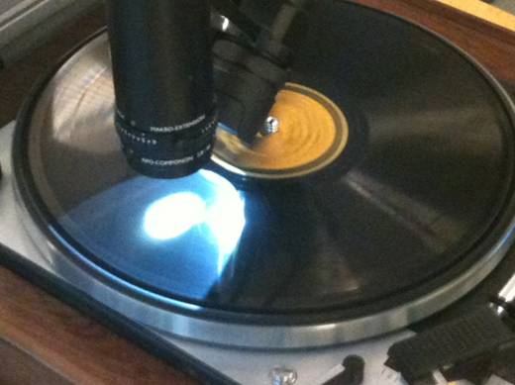
It all started ……..
a demonstration of optical playback of a 78 rpm
was surprisingly good sound quality
Notes:
It all started when we was contacted with a company that showed a demonstration of optical playback of a 78 rpm and it was a surprisingly good sound quality with simple technical equipment were used.
We had discussions with the company and described our need to be able to transfer the discs faster than real time and at the best possible sound quality.
The technical equipment for image scanning used by the company was taken directly from the shelf and had not been optimized for the applications we requested. They also indicated that image scanning operations and transfers could be faster than normal playback.
We were looking for sponsors to investigate if the potential of the technology could have what we asked for.
With this material and proposals for a development project, we ended up finally to the innovation agency VINNOVA. We made an application with the project description to VINNOVA and got it granted as an innovation procurement, PCP (Pre Commercial Procurement). The project started 1th January 2014 and ends on 31th August 2015. We had no previous experience of innovation procurement and it has been very interesting to run the project with the development process that applies to this type of ”pre commercial procurement”. During the whole project there have been a form of cooperation and dialogue, but also clear boundary issues of secrecy for the companies involved, these connections create a good and challenging development and exchange of information.

Slide 5
Received totally 8 technical proposals
Selected five companies with solutions that proceeded to Phase 1. -Preliminary study and detailed description of its prototype solution.
Examination of Phase 1 reports and interviews by these companies
We selected three companies now participating in the Phase 2 -Development and production of prototypes
Notes:
We received totally 8 technical proposals from various companies in our procurement. They had no professional experienses of audiorecordings. We selected five companies with innovation solutions that progressed to Phase 1. In the continued work in Phase 1 includes producing a report on a preliminary study and detailed description of its prototype solution. After examination of these Phase 1 reports and an associated round of interviews by these companies, we made a second new selection. We selected three companies now participating in the Phase 2 of development and production of prototypes. They have to make production of sounding results with audio files from 78's and vinyl records. In Phase 2 includes a number of goals that should be reported and be checked before the final report.

Slide 6
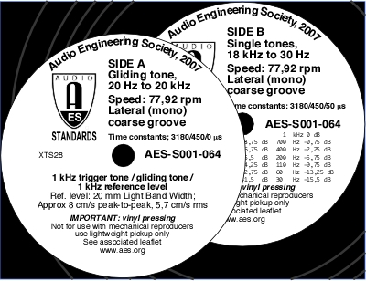
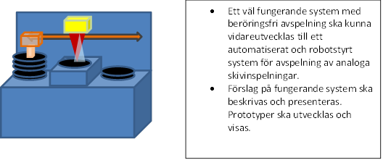
Different solutions
Referens and test records, 78 rpm and vinyl discs
Working with 2D and 3D scanning methods, laser or LED
Final reports on 24th August 2015
Evaluate the final results
How realistic the application and automated digitalization could be designed ….
Notes:
>Describe the different solutions involved, pictures and listen to audio files <
The companies now participating in the Phase 2 have different proposed solutions that make it very interesting to see how the results may differ. They should preliminarily submit final reports on 24th August with presentations of the results achieved and suggest future technical solutions that they have developed. After the project have been finish we are going to evaluate the final results to see if and how we will proceed in our continuing work with optical playback.

Slide 7
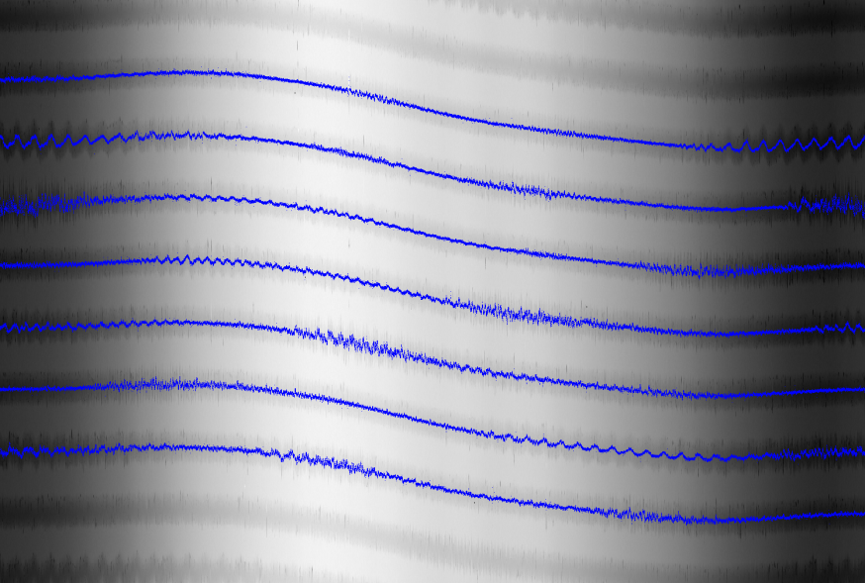
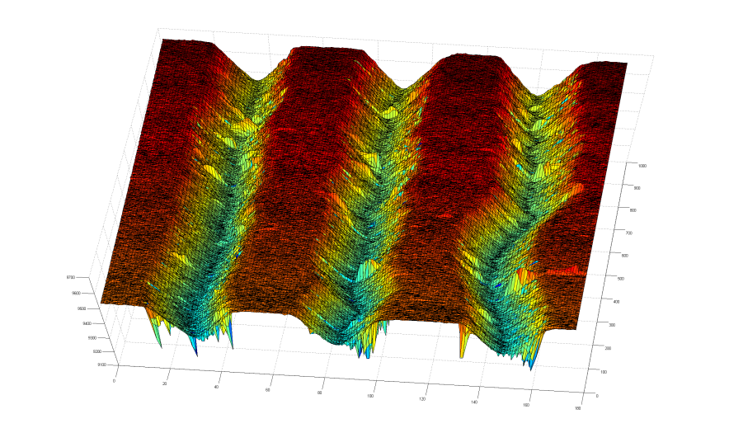
One company ….3D with 78 rpm
Notes:
MBV Systems AV working with 3D scanning – have produced a soundfile ….

Slide 8
Second company….. 2D with vinyl
Notes:
Invite Vision AB is another company working with

Slide 9
Third company….. 2D ”Optofon”
Got a report - evaluation, planning, technology purchases
…..
Notes:
Joroma AB (Optonova) is one of the companys

Slide 10
Different solutions
Referens and test records, 78s and vinyl discs
Working with 2D and 3D scanning methods, laser or LED
Final reports on 24th August 2015
Evaluate the final results
How realistic the application and automated digitalization could be designed
Notes:
Important that we have reference and test records to compare with normal replaying or with ELP- laser turntable
Depending on the results achieved of the sound quality and how quickly and efficiently you may transfer the records we evaluate how realistic the application and automated digitalization could be designed. It should be clear from the companies’ final reports that their optical playbacks and technical solutions have the potential to achieve the quality we demand. There can be results that we get from the optical playback of 78 rpm that achieve the quality we demand, but not for transferring micro-groove discs (vinyl). If the results are not going to be what we want and be good enough should the reasons be described what it depends on. It may be that new technical possibilities of optical scanning technology will be further developed in the near future and provide new solutions. It can then perhaps create opportunities for optical transmission and image processing and provide the results we are demanding of full quality during playbacks.

Slide 11
Depending on the results ….
Organize a workshop during the autumn this year,
presentations of the results
Will be on a conference in Washington at The Library of Congress "Audio Media Preservation through Imaging”, 15th-17th July 2015
Notes:
Depending on the results obtained and the potential that may exist, we plan to organize a workshop during the autumn where presentations of the results that emerged from the participating companies.
I will also participate in a conference in Washington at The Library of Congress with the content "Audio Media Preservation through Imaging”, 15th-17th July. They have been working with the IRENE-project for many years.

