Slide 1
Europeana Sounds – Uniting the sounds of Europe
Richard Ranft (British Library)
Zane Grosa (National Library of Latvia)
IASA Nordic conference, 26 May 2015, Copenhagen

Slide 2
Current extent of Europeana
a single access point to Europe’s cultural heritage…
…aggregates metadata records - at continental scale - from 3,000 cultural heritage institutions across Europe…
… that link to 41 million objects: photos, books, paintings, sounds, videos, etc, from 36 countries
multilingual interface in 30 European languages

Slide 4
Europeana content
From galleries, libraries, archives, museums, AV collections
From all 28 EU member states, plus 8 other countries
24m images
16m texts
0.52m sounds
0.70m videos
21,000 3-D objects
Note: sound = 1.5% of total, but x10 number of accesses

Slide 5
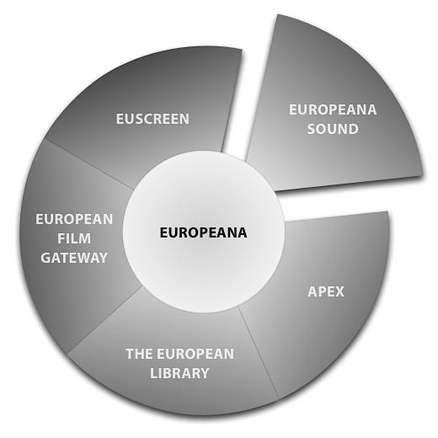
Europeana Sounds project
“Europe’s Sound Heritage at your fingertips”
Feb 2014 – Jan 2017
Represents the 5th aggregation domain, alongside EFG, EUscreen, APEX, TEL

Slide 6
Objectives
Double the number of audio items on Europeana, to >1m; additional 0.2m related items: scores, texts, images, videos
Improve discovery and use by enriching and cross-linking metadata for 2m audio and related items
work with rights holders to unlock access to Europe’s audio heritage
Improve usability by creating Europeana channels for audio and other content
improve Europeana’s technical infrastructure for aggregating time-based content
Promote among end-users and other content providers
build a sustainable network of content providers with IASA

Slide 7
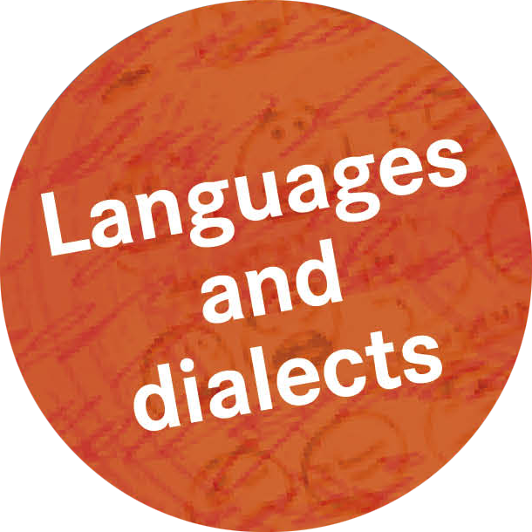
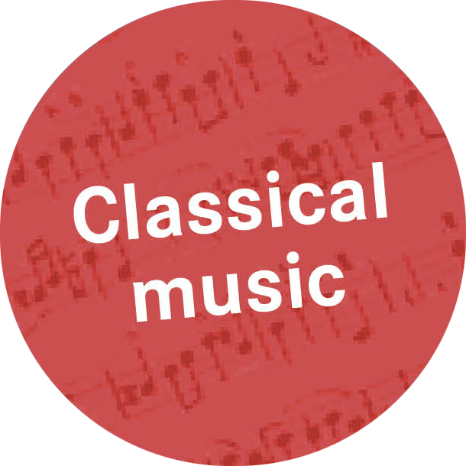
Notes:
Subjects

Slide 8
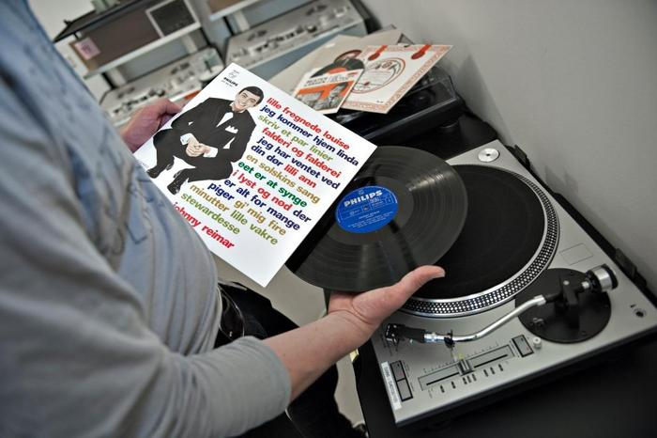
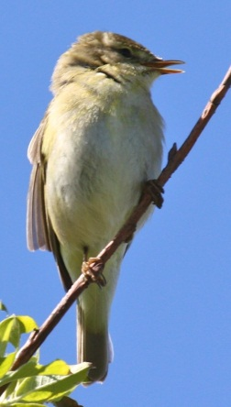
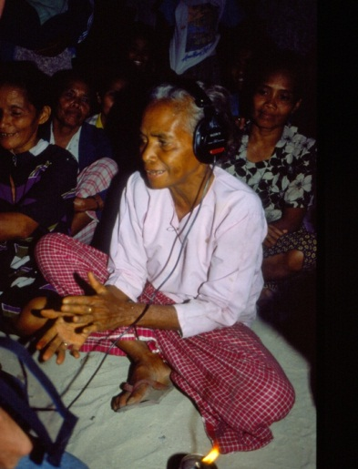
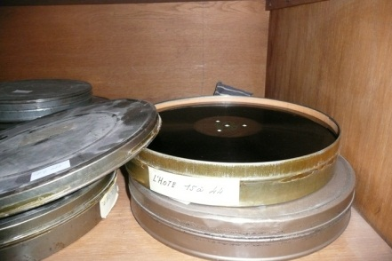
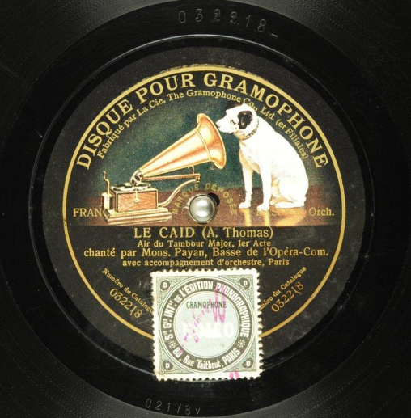
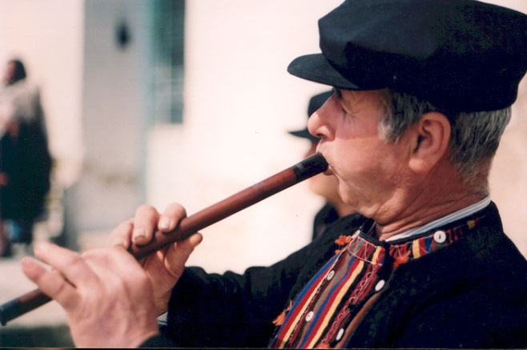
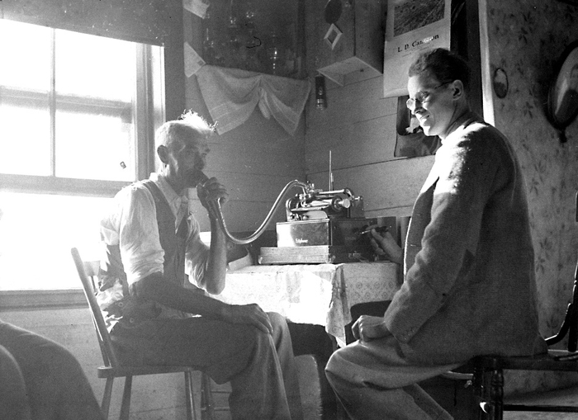
Link different digital objects
Sounds, images, photographs, sheet music, etc.

Slide 9
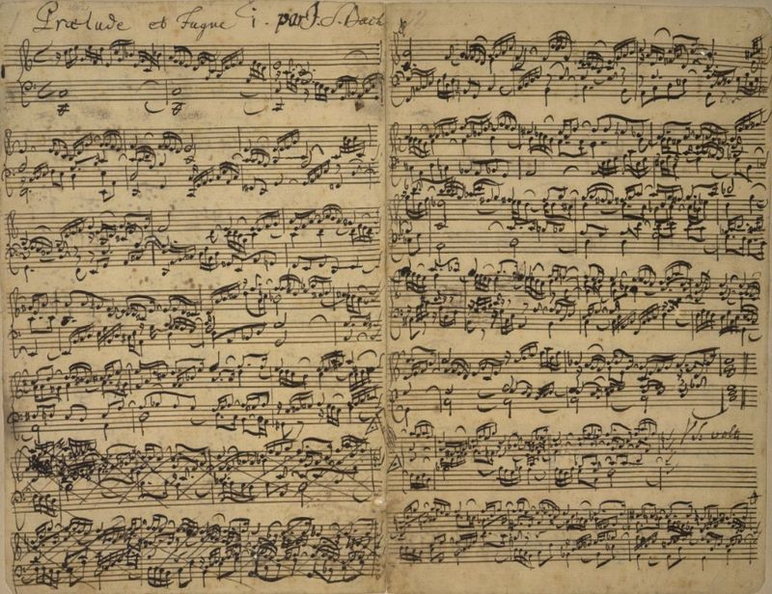
Uniting cultural items
BWV 870 JS Bach Well-Tempered Clavier - Prelude and Fugue in C major
Manuscript score (Source: The British Library. Add.MS 35021)
Audio recording (Source: recorded example from Europeana Helsinki City Library).
Notes:
Inter-linked across formats, and data providers
Score following

Slide 10
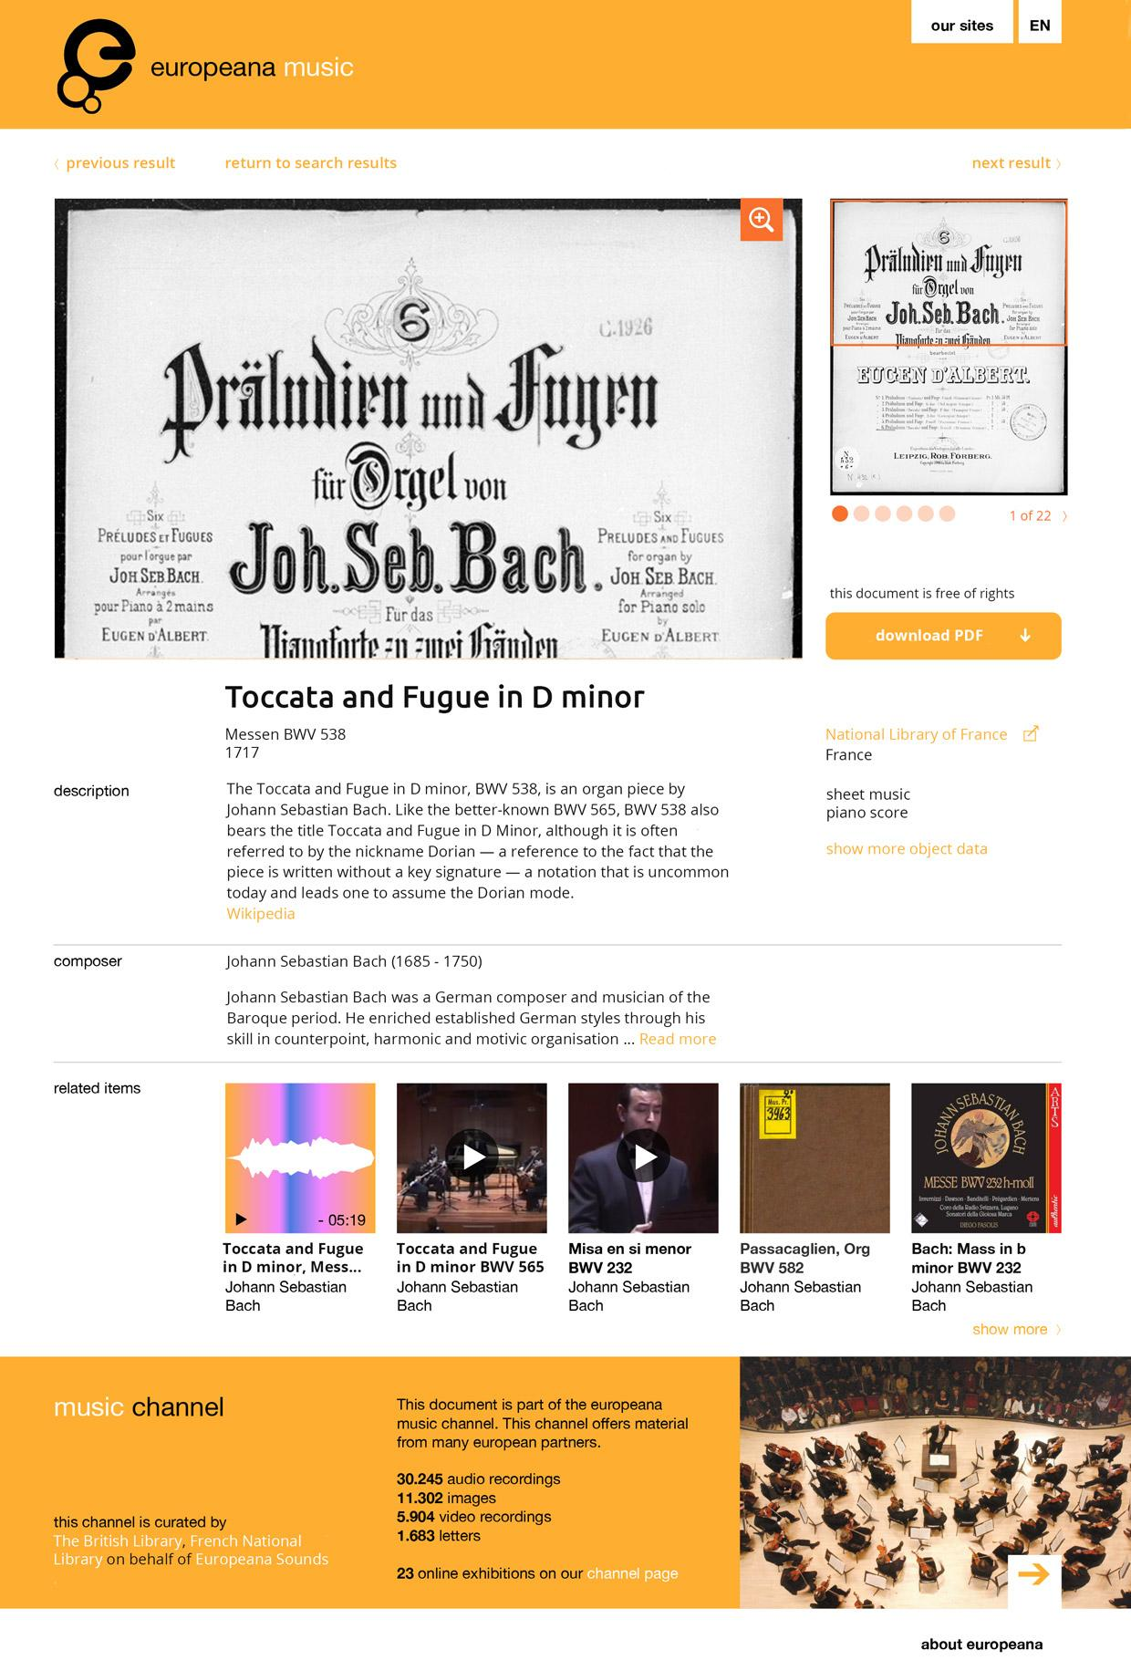
Europeana channels
Notes:
Pages for ‘culture vultures’
Profiles of composers

Slide 11
Project outline
3 years: Feb 2014 – Jan 2017
€6.1m total budget, 80% EC funded (€4.9m EC contribution)
funded by European Union’s ICT Policy Support Programme as part of the Competitiveness and Innovation Framework Programme

Slide 12
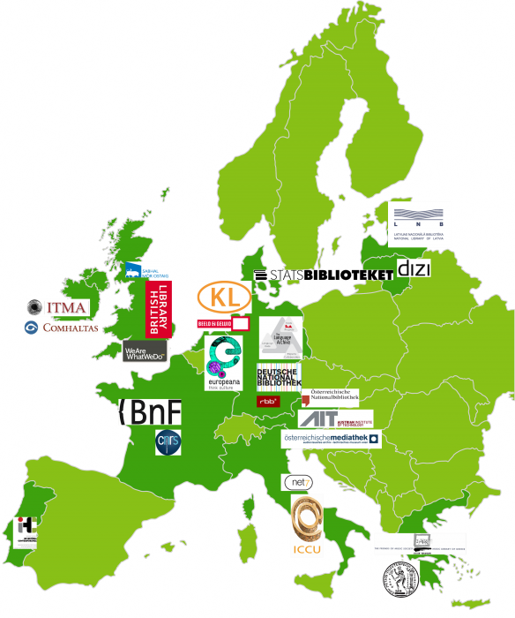
Project partners
24 organisations from 12 countries
7 National Libraries
5 Archive & Research Centres
2 other Public Bodies
4 Non-profit Organisations
3 Universities
3 Companies
+ work with SoundCloud, Spotify, HistoryPin - and IASA
europeanasounds.eu
Notes:
-Includes Latvia, Lithuania and Denmark partners
-Establish sustainable Europeana task force within International Association of Sound and Audiovisual Archives (IASA)
additionally involves representatives from Wikimedia Sweden and Nordic member Pekka Gronow who recently joined the project’s Advisory Board
Over to Zane to talk specifically about NLL in the project

Slide 13
National Library of Latvia (NLL)
Main role – content provider – WP1 (Aggregation)
Also in dissemination (WP6), licensing/copyright issues (WP3)
National content aggregator for Europeana
Previous experience in other Europeana projects:
- Europeana Awareness
- Europeana Inside
- Europeana Newspapers
Notes:
NLL’s main role in the project – one of the content providers
NLL is the nat. aggregator for Europeana, and has been active in other projects, connected with Europeana, which has given valuable previous experience.

Slide 14
Content
audio.lndb.lv
Notes:
NLL participates with the content from its online historical sound recording collection

Slide 15
Content
audio.lndb.lv
Notes:
This collection consists of digitized shellac records, and includes mostly music of various genres, as well as some radio broadcasts from 1930s. A large part of the collection is freely available online, but recordings protected by copyright are available only within the library and on protected library network (includes public libraries in Latvia).

Slide 16
Audio collection - example
Notes:
An example – fragment of piece by Danish composer Jacob Gade, currently we have 2 pieces by him (also Serenade) in the collection, but as they are protected by copyright, they are available to listen only within the library.

Slide 17
Metadata mapping in MINT
Notes:
To make the audio objects available on Europeana, metadata has to be mapped according to the EDM Sounds metadata profile which has been developed especially for this project. Metadata mapping was done in MINT environment.

Slide 18
Metadata mapping in MINT
Notes:
A useful feature in MINT is the preview function, which lets you see how the item would look in Europeana. In this example, note that we have provided the Alternative title (in the original language), and detailed subject, which is taken from the Library of Congress thesaurus. Hopefully these features will make the item better findable.

Slide 19
Project website and blog
www.europeanasounds.eu
Notes:
The project website gives each project partner the opportunity to promote its collection, or write about currently important themes. Often, sound clips are embedded in the article via SoundCloud.

Slide 20
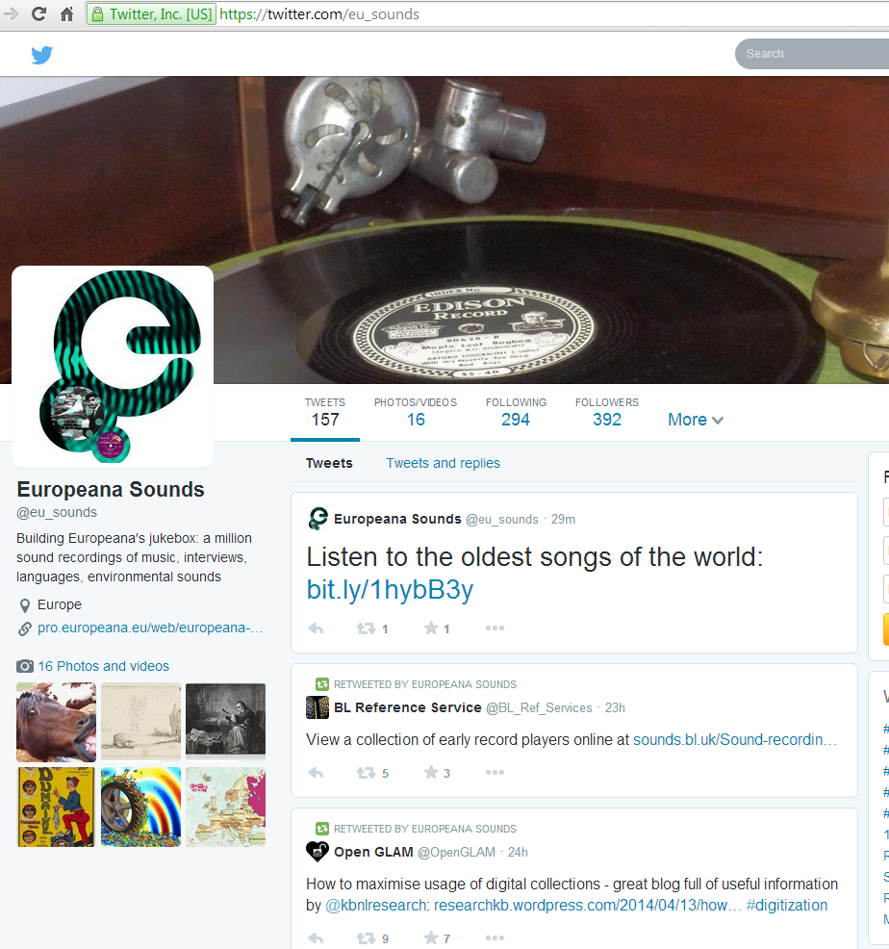
Get involved
@eu_sounds
https://www.facebook.com/soundseuropeana
IASA 2015 conference, Paris: workshop - Preparing metadata for Europeana to improve discoverability of audio archives, October 1st.
1st Europeana Sounds conference “The Future of Historic Sounds”: 2 October @ BnF (right after IASA’s conference)
Notes:
Twitter
Facebook
New data providers…
Conference

Slide 21
Notes:
[Connect to the internet to play this embedded Vimeo video]

Slide 22
thanks for listening!
Richard.Ranft@bl.uk
Zane.Grosa@lnb.lv
@eu_sounds

