Slide 1
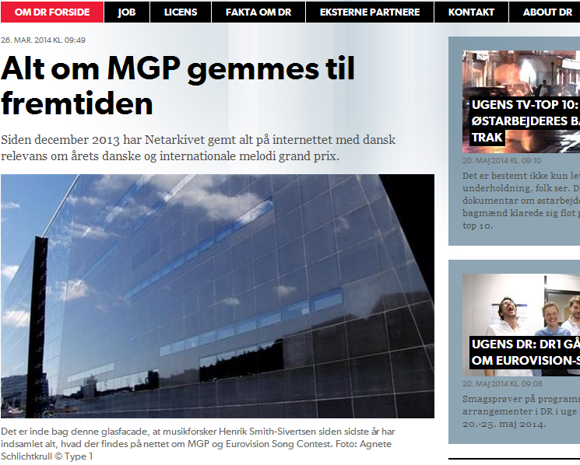
ESC 2014 Project
Everything about ESC is preserved for the future

Slide 2
ESC 2014 Project
Adopted early December 2013 (RESAW)

Slide 3
ESC 2014 Project
Why ESC as a case?
ESC has a massive social media presence and generates a lot of content. It is very technologically demanding to harvest.
(from the project description (january 2014)).

Slide 4
ESC 2014 Project
Why ESC as a case?
ESC has a massive social media presence and generates a lot of content. It is very technologically demanding to harvest.
Doing so tests the Netarchive functionality and gives valuable experience wrt. needed improvements, and input about which technological solutions are needed.
(from the project description (january 2014)).

Slide 5
ESC 2014 Project
Why ESC as a case?
ESC has a massive social media presence and generates a lot of content. It is very technologically demanding to harvest.
Doing so tests the Netarchive functionality and gives valuable experience wrt. needed improvements, and input about which technological solutions are needed.
ESC-related research is diverse; music, politics, culture, language, gender, media, and more. Accomodating these different angles challenges the collections and collection process and strategy.
(from the project description (january 2014)).

Slide 6
ESC 2014 Project
Why ESC as a case?
ESC has a massive social media presence and generates a lot of content. It is very technologically demanding to harvest.
Doing so tests the Netarchive functionality and gives valuable experience wrt. needed improvements, and input about which technological solutions are needed.
ESC-related research is diverse; music, politics, culture, language, gender, media, and more. Accomodating these different angles challenges the collections and collection process and strategy.
The transnational aspect of ESC makes it a superb case for collaboration (RESAW)
(from the project description (january 2014)).

Slide 7
ESC 2014 Project
Project description (January 2014)
Ongoing event harvest up to the Eurovision Song Contest in Copenhagen on 10th May 2014

Slide 8
ESC 2014 Project
Project description (January 2014)
Ongoing event harvest up to the Eurovision Song Contest in Copenhagen on 10th May 2014
Focusing on ESC 2014 as an online event, especially social media (including AV)

Slide 9
ESC 2014 Project
Project description (January 2014)
Ongoing event harvest up to the Eurovision Song Contest in Copenhagen on 10th May 2014
Focusing on ESC 2014 as an online event, especially social media (including AV)
Creation of the archive is overseen by reseachers and specialists, who, in collaboration with the Netarchive curators, find and add material and provide quality control

Slide 10
ESC 2014 Project
Project description (January 2014)
Ongoing event harvest up to the Eurovision Song Contest in Copenhagen on 10th May 2014
Focusing on ESC 2014 as an online event, especially social media (including AV)
Creation of the archive is overseen by reseachers and specialists, who, in collaboration with the Netarchive curators, find and add material and provide quality control
The archive is limited to the Danish contest (Dansk Melodi Grand Prix) and the international ESC contest

Slide 11
The Problem:
is – in a nutshell – about really big data
http://youtu.be/icpmWShvGNk

Slide 12
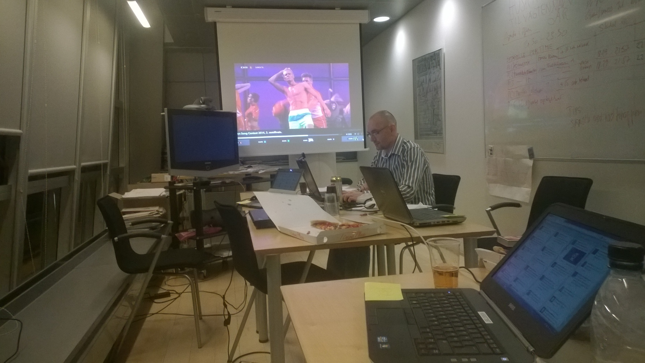
The Control Center
- a manual experience

Slide 13
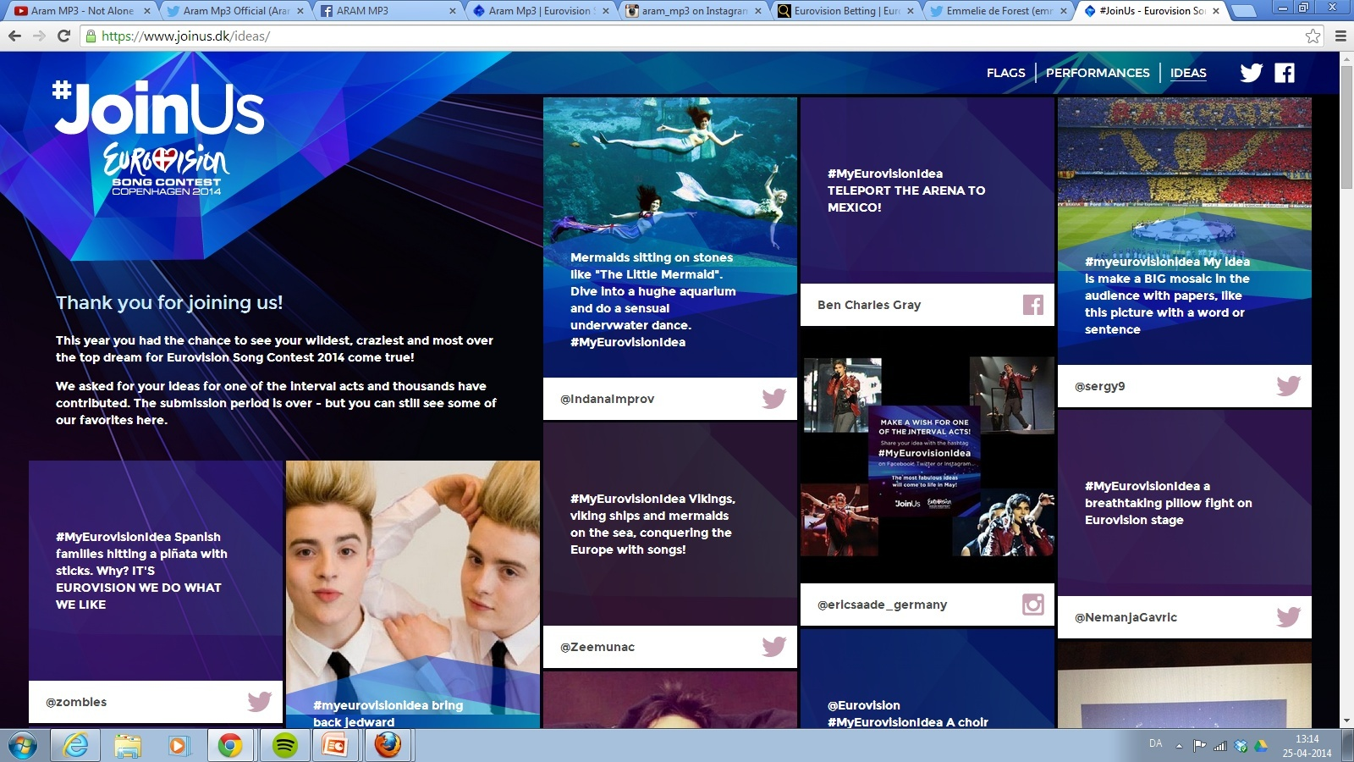
Results & Experiences
From day 1 we had our work cut out for us by the (now dreaded) dynamic content:

Slide 14
Opening of the 1st semi-final:
http://youtu.be/3B0KLCPYc68?t=2m

Slide 15
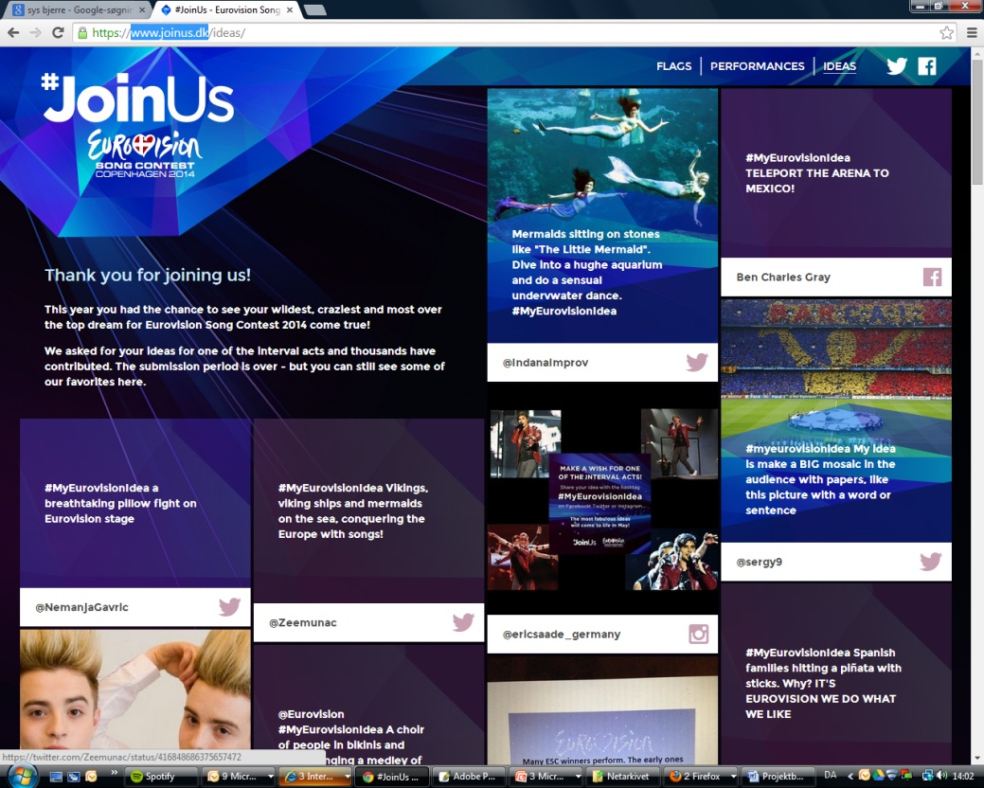
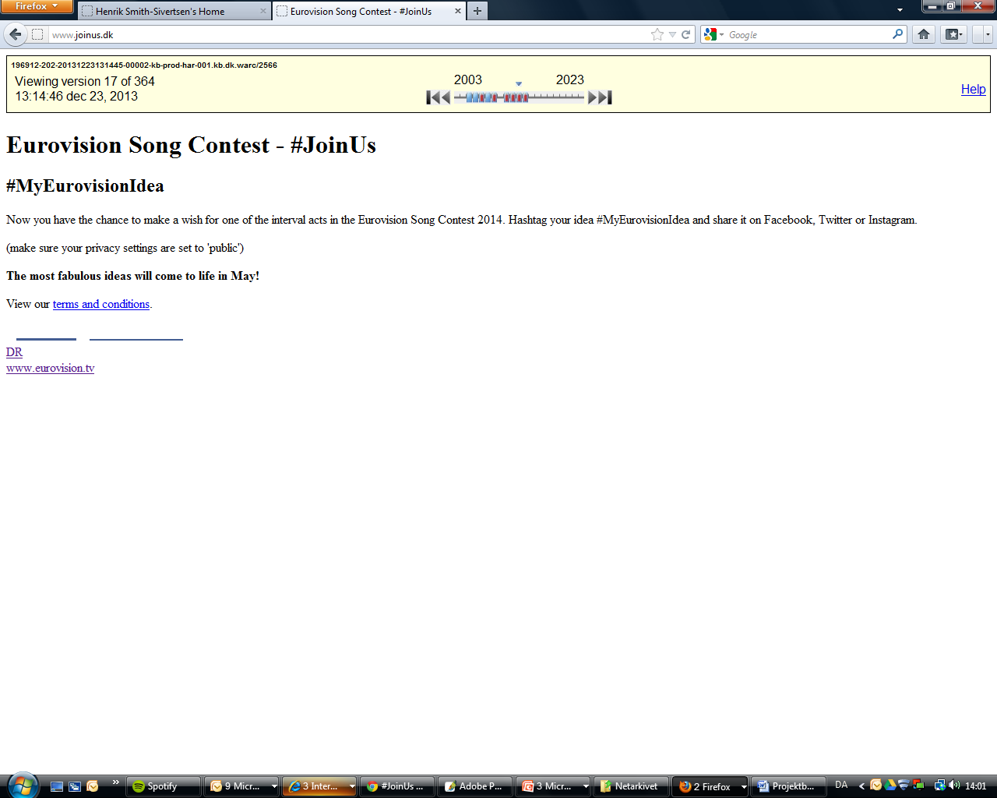
Results & Experiences
From day 1 we had our work cut out for us by the (now dreaded) dynamic content:

Slide 16
Results & Experiences
Static pages with no dynamic elements are archived without any problems. These are sites such as news sites, fan sites and betting pages
A lot of these sites have high levels of activity, which demands that we keep close watch, for instance for newly sprouted sub-pages etc.

Slide 17
Results & Experiences
Social media activity is enormous in scope:
321.000 videos when using the query ”Eurovision 2014” on YouTube:

Slide 18
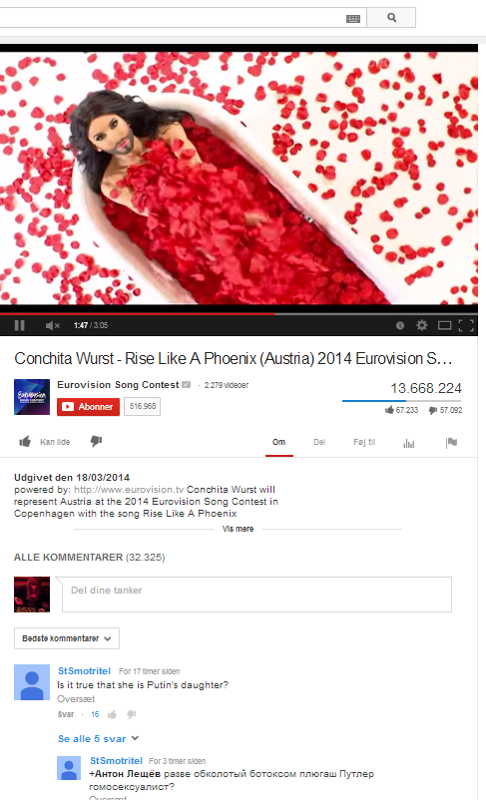
13.668.244 Views of the
winning song’s official video
(One week after the victory)

Slide 19
Social media is more than text

Slide 20
Social media is more than text
- and this is how they work
Via inter- and re-references

Slide 21
Social media is more than text
- and this is how they work
Via inter- and re-references
Multi- media

Slide 22
Social media is more than text
- and this is how they work
Via inter- and re-references
Multi- media
Visual commentary

Slide 23
Social media is more than text
- and this is how they work
Via inter- and re-references
Multi- media
Visual commentary
but even more
ESC is mainstream

Slide 24
Social media is more than text
- and this is how they work
Via inter- and re-references
Multi- media
Visual commentary
but even more
ESC is mainstream
People – fans, anti-fans and casual viewers – relate to it

Slide 25
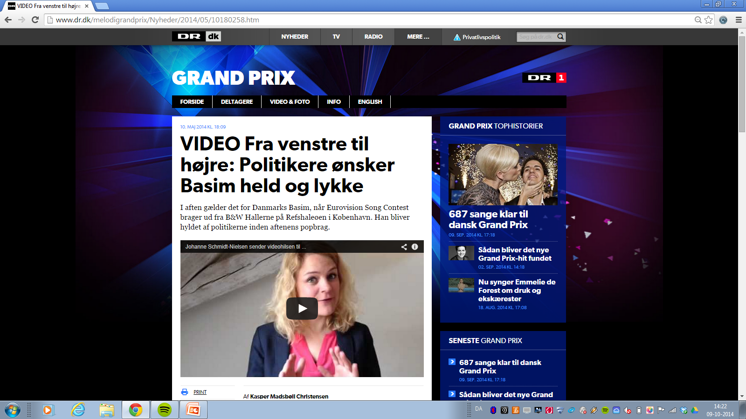
It is not ”just” music either…
Danish TV’s official ESC news site

Slide 26
Saved in the Netarchive:
http://www.dr.dk/melodigrandprix/Nyheder/2014/05/10180258.htm
(Danish TV’s official ESC news site)

Slide 27
Results & Experiences
YouTube
The Netarchive is able to save the video front pages, showing no. of ”likes”, ”dislikes” and ”views”, but cannot save the comments
Videos themselves are saved manually and separately to the archive

Slide 28
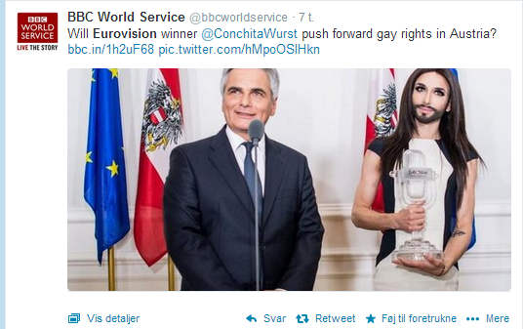
Results & Experiences
Social media activity is massive:
47.000 tweets a minute during the final (and that is way too much for the Netarchive)

Slide 29
Problems & Solutions
Problem: The Netarchive cannot harvest social media due to frequency of updates, page coding etc. – ie. tech issues
> Solution:
Twitter and Facebook:
Digital Footprints
Screen shots
Screen film

Slide 30
Problems & Solutions
Problem: The Netarchive cannot harvest social media due to frequency of updates, page coding etc. – ie. tech issues
> Solution:
b) YouTube:
Videos and front pages were harvested separately, and a spreadsheet is needed to match them. Comments are not harvested.

Slide 31
Problems & Solutions
Problem: The Netarchive cannot harvest social media due to frequency of updates, page coding etc. – ie. tech issues
> Solution:
c) Joinus.dk (mostly), Instagram, Tumblr, VK.com, Vimeo, Flickr, streaming on news sites et al…

Slide 32
Conclusion
ESC 2014 has proven that social media are vital, if we want to preserve an accurate impression of our present time.

Slide 33
Conclusion
ESC 2014 has proven that social media are vital, if we want to preserve an accurate impression of our present time.
Established news media (”old media”) interact with them – even in their logo/branding – and debates on social media can affect the outcome of something like ESC, just as they can affect policy and policy making.

Slide 34
Conclusion
ESC 2014 has proven that social media are vital, if we want to preserve an accurate impression of our present time.
Established news media (”old media”) interact with them – even in their logo/branding – and debates on social media can affect the outcome of something like ESC, just as they can affect policy and policy making.
Online discourse is not pure text, but uses a multi-media approach – everything is connected and inter-referential.
This puts new and high demands on archiving.

Slide 35
Conclusion
ESC 2014 has proven that social media are vital, if we want to preserve an accurate impression of our present time.
Established news media (”old media”) interact with them – even in their logo/branding – and debates on social media can affect the outcome of something like ESC, just as they can affect policy and policy making.
Online discourse is not pure text, but uses a multi-media approach – everything is connected and inter-referential.
This puts new and high demands on archiving.
Two kinds of problems
Technical error and complication (ie. things we cannot do – yet)
Human error

Slide 36
Conclusion
A massive amount of work has gone into harvesting and documenting ESC 2014, and this has led to a large and excellent material for future research. However, a lot of this material is currently outside the Netarchive proper.

Slide 37
Conclusion
A massive amount of work has gone into harvesting and documenting ESC 2014, and this has led to a large and excellent material for future research. However, a lot of this material is currently outside the Netarchive proper.
The Netarchive lacks the technology to harvest the media of the now. Without tools to do so, the source material we pass on will be incomplete and unable to accurately reflect the present day in our preserved material.

Slide 38
Conclusion
A massive amount of work has gone into harvesting and documenting ESC 2014, and this has led to a large and excellent material for future research. However, a lot of this material is currently outside the Netarchive proper.
The Netarchive lacks the technology to harvest the media of the now. Without tools to do so, the source material we pass on will be incomplete and unable to accurately reflect the present day in our preserved material.
Whole domains/sites are currently impossible to harvest

Slide 39
Conclusion
A massive amount of work has gone into harvesting and documenting ESC 2014, and this has led to a large and excellent material for future research. However, a lot of this material is currently outside the Netarchive proper.
The Netarchive lacks the technology to harvest the media of the now. Without tools to do so, the source material we pass on will be incomplete and unable to accurately reflect the present day in our preserved material.
Whole domains/sites are currently impossible to harvest
And therefore we now have AV-collections of activities on Twitter, Facebook etc.

Slide 40
Conclusion
Curation is vital – the amount of data is so large and the choices so many that we need more resources.

Slide 41
Conclusion
Curation is vital – the amount of data is so large and the choices so many that we need more resources.
Social media use/practices is one of the challenges of this collection.
What to collect from where and how
What do people do on Facebook vs. YouTube vs. Twitter etc.

Slide 42
Conclusion
Curation is vital – the amount of data is so large and the choices so many that we need more resources.
Social media use/practices is one of the challenges of this collection.
What to collect from where and how
What do people do on Facebook vs. YouTube vs. Twitter etc.
The devil really is in the detail
Small mistakes muddy the collection

Slide 43
Conclusion
Curation is vital – the amount of data is so large and the choices so many that we need more resources.
Social media use/practices is one of the challenges of this collection.
What to collect from where and how
What do people do on Facebook vs. YouTube vs. Twitter etc.
The devil really is in the detail
Small mistakes muddy the collection
Time and timing is essential

Slide 44
ESC 2014 Project
”As my dad used to say: any failed attempt is a victory for those who have the strength to make a new, better one.”
- Jan Guillou 2013 (our translation)

